Slide 1

ChangeKeeper
an app by Diogo Silva(89348) & Vasco Ramos(88931)
presented in May 29th for the IHC subject (P4)

Slide 2




The Problem
?
Needlessly Complicated
?
Bank account binding
X
No loan capabilities

Slide 3


The Idea
Easy-to-use
Keeps track of all transactions
Targeted towards teens & young adults
Manages allowances/subscriptions

Slide 4





The Persona
Jõao Dias
20 years old
2º year Bachelor
Moved to Aveiro
Monthly Allowance
Gym Subscription

Slide 5
The Persona
Jõao Dias
Can’t keep track of expenses
Takes too long to manage funds
Wants an easy & straightforward way to manage his money
+
That’s where ChangeKeeper comes in!

Slide 6

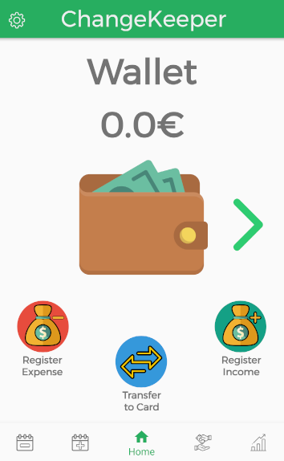
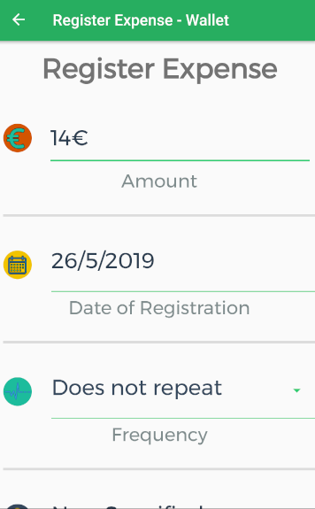
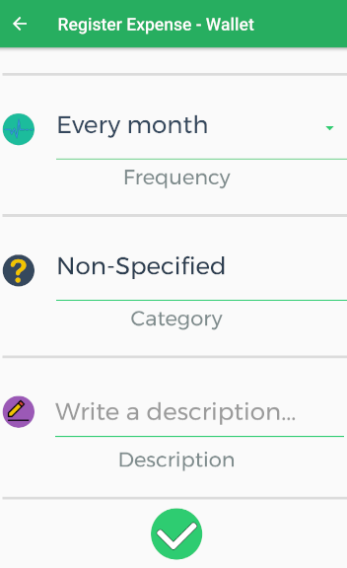
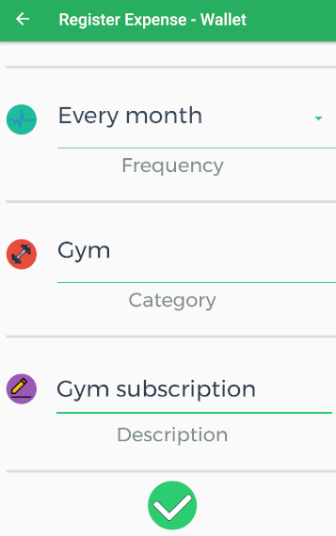

The Scenarios - 1
Insufficient Money to pay the gym subscription

Slide 7
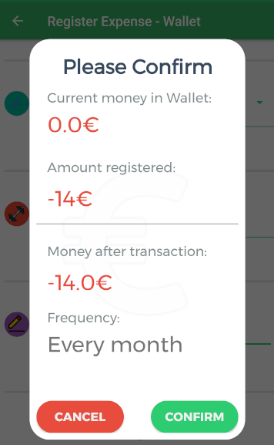
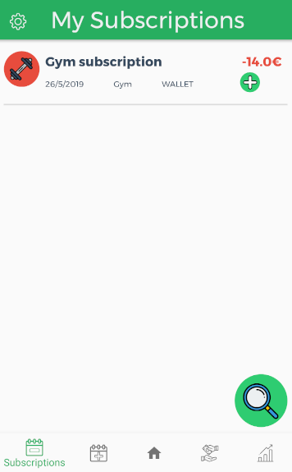
The Scenarios - 1
Insufficient Money to pay the gym subscription

Slide 8
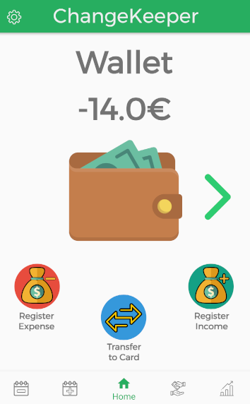
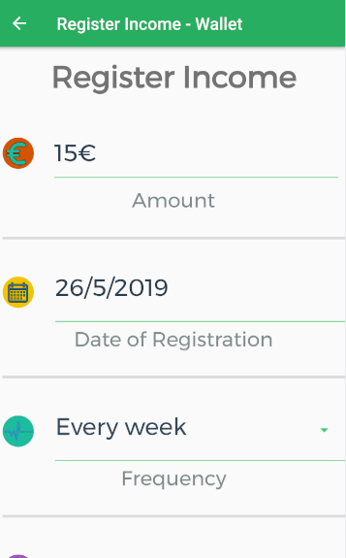
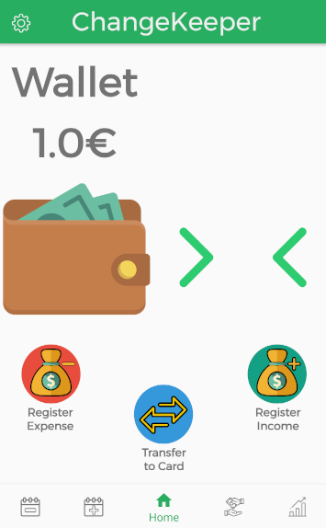
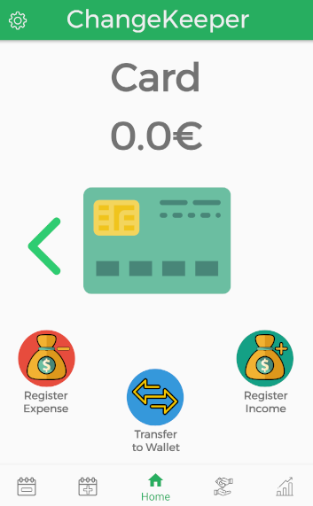
The Scenarios - 2
Problems managing wallet & card funds

Slide 9
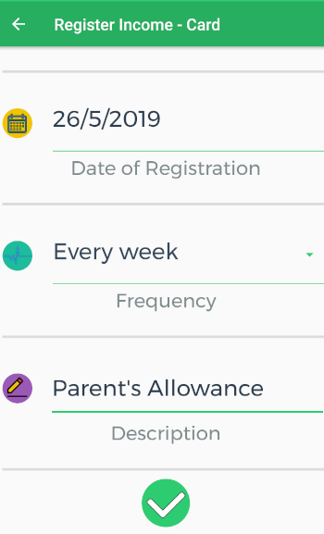
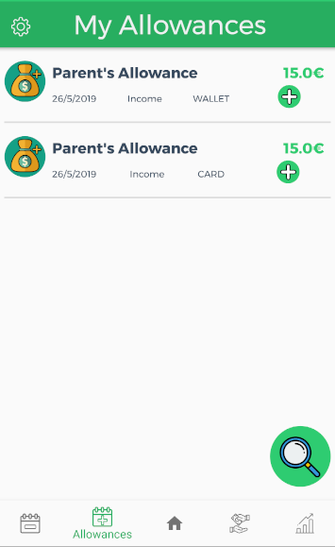
The Scenarios - 2
Problems managing wallet & card funds

Slide 10
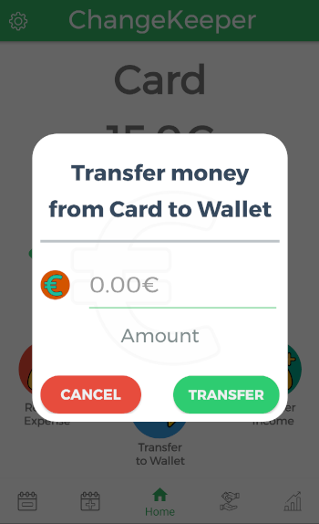
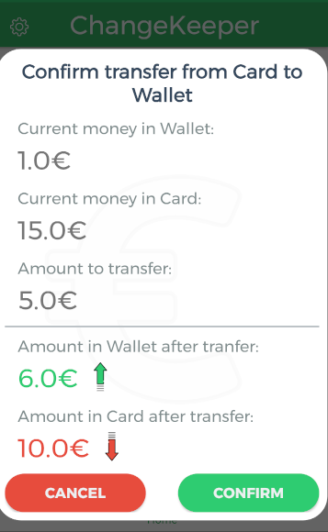
The Scenarios - 3
Transfer Money from card to wallet

Slide 11

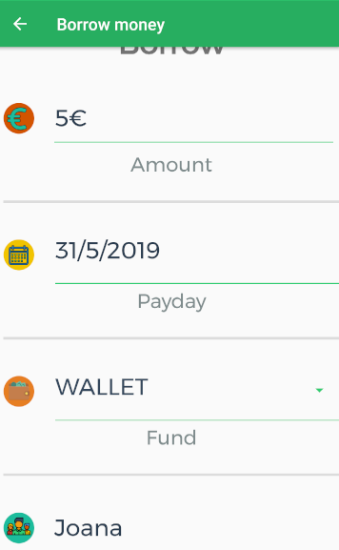
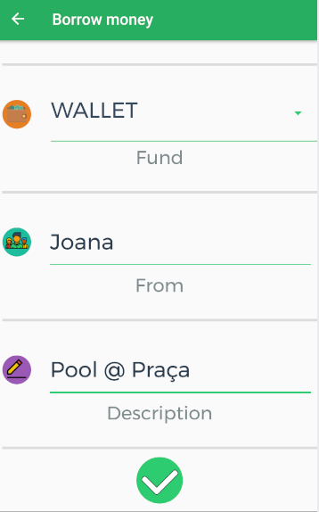
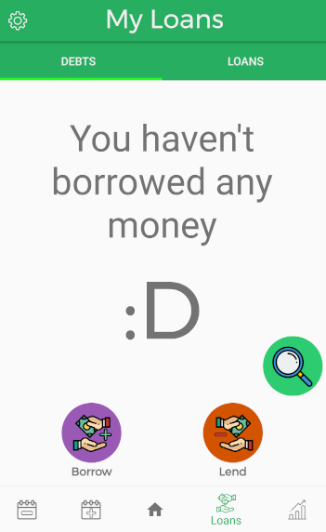
The Scenarios - 4
Borrow money to play pool

Slide 12
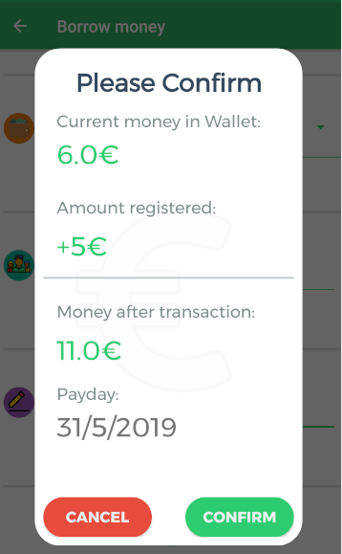
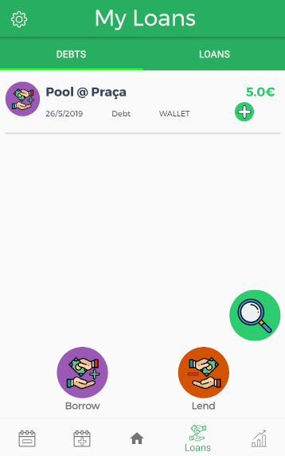
The Scenarios - 4
Borrow money to play pool

Slide 13
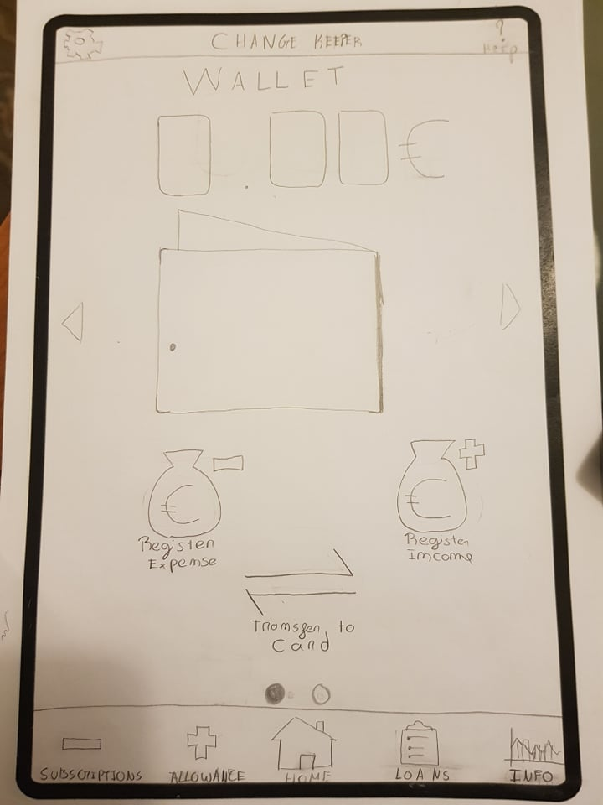
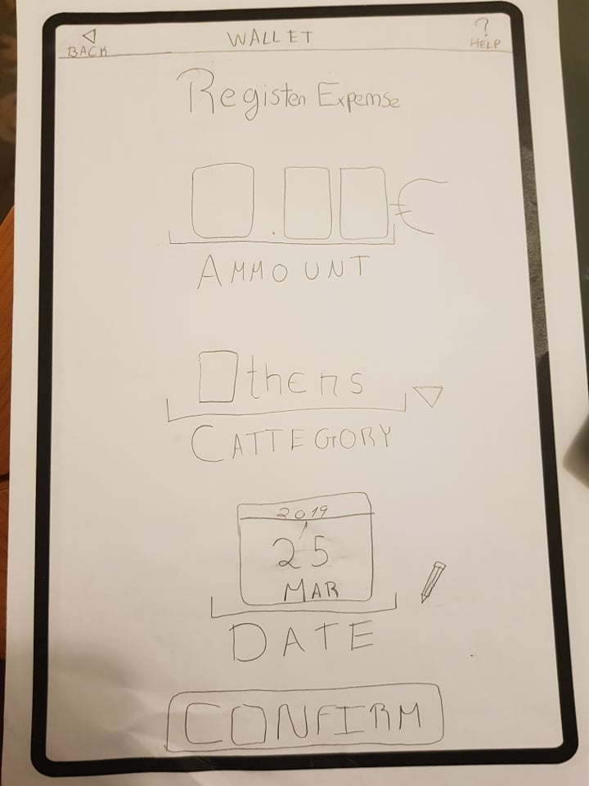
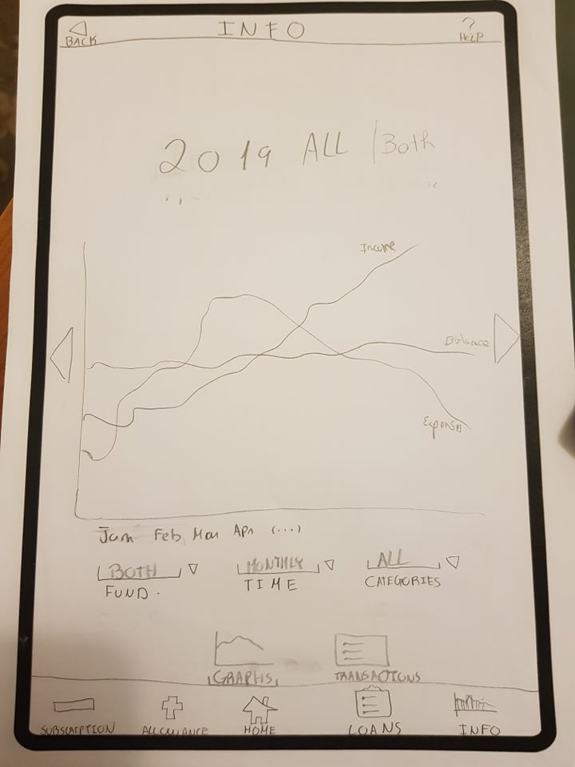
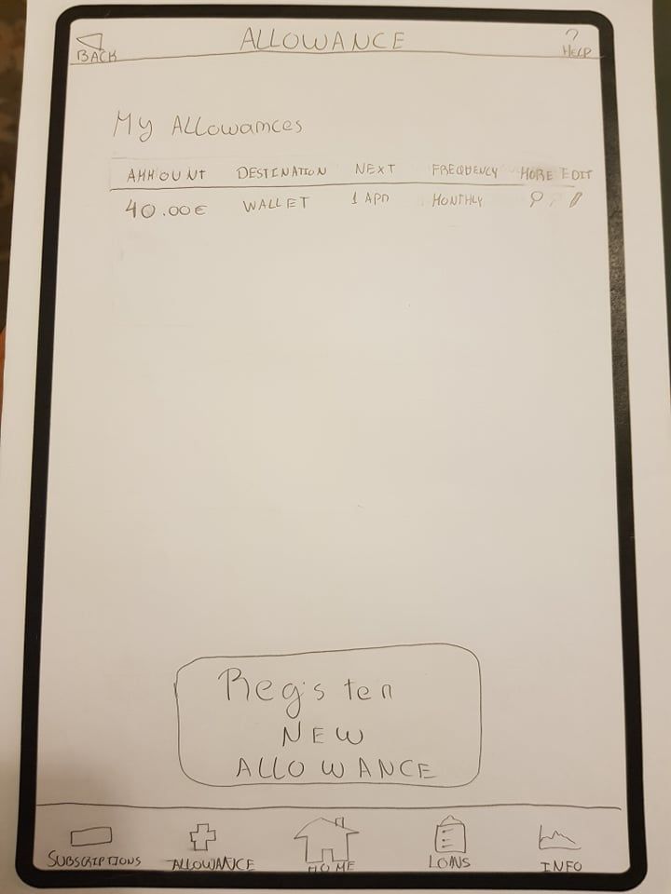
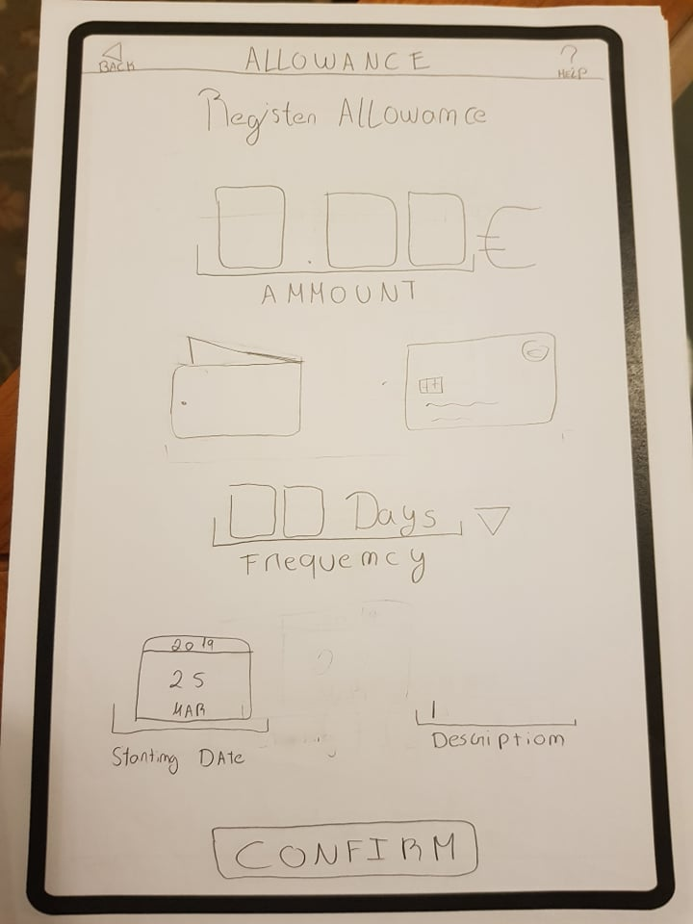
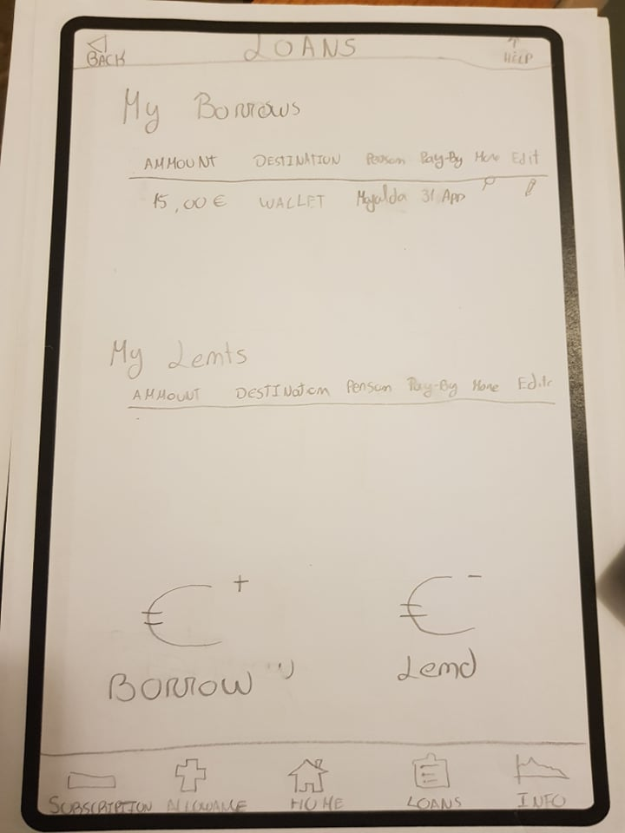
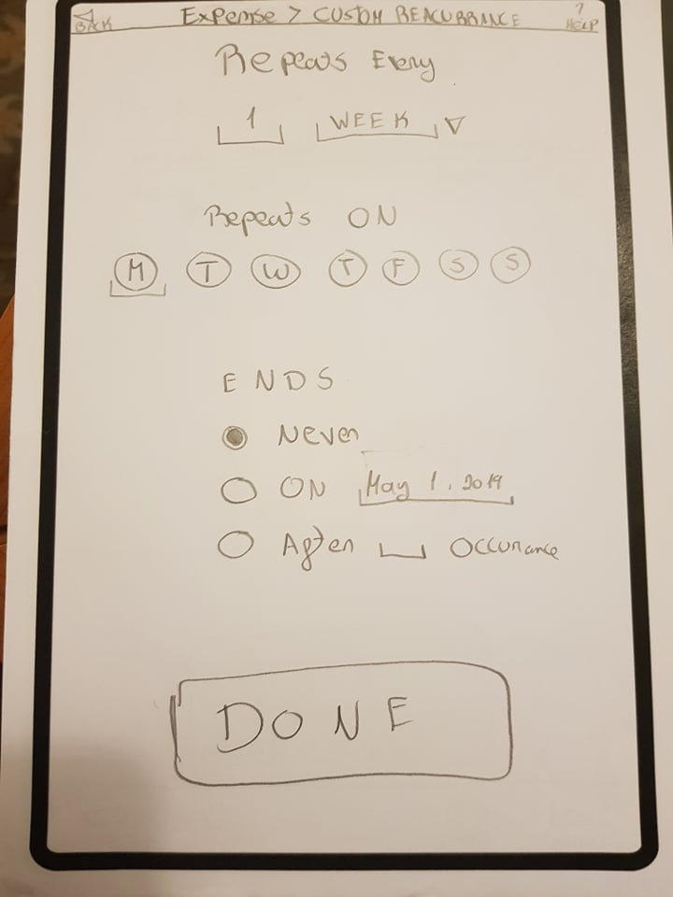
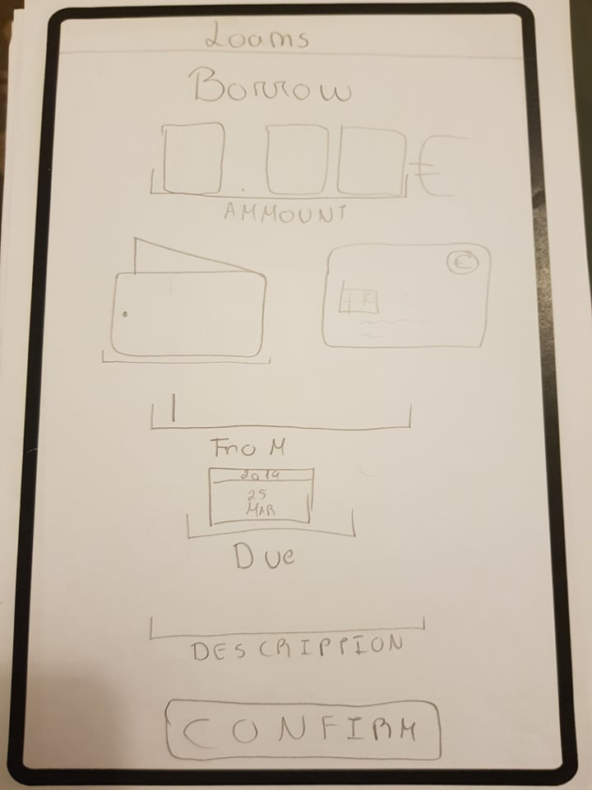
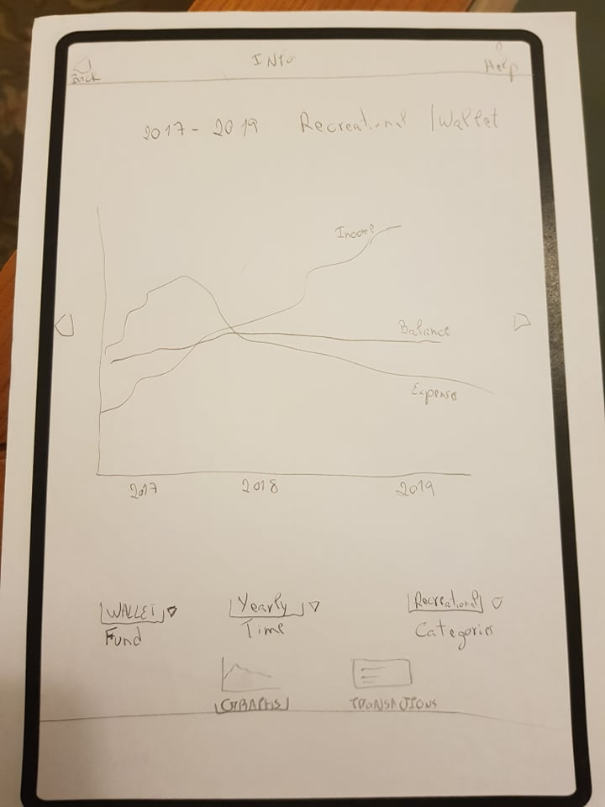
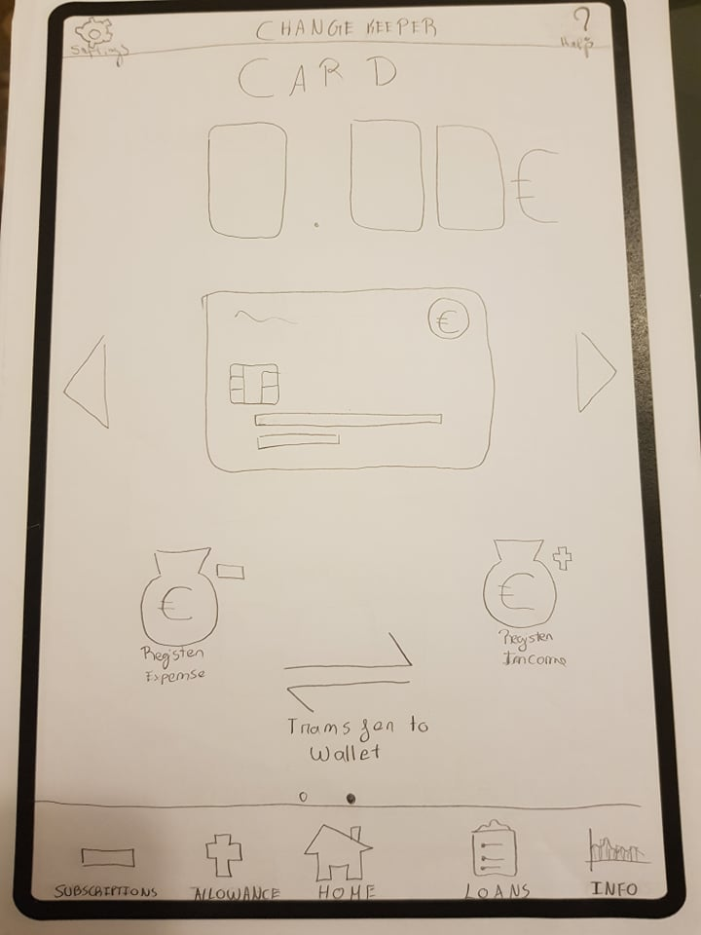
The Prototype - Tests
Regist wallet expense
Regist monthly card income
Regist money borrow
Transfer money from card to wallet
Check info on registered transactions

Slide 14

The Prototype - Results
8 participants
Positive feedback! (but…)
Suggestions for improvement!

Slide 15
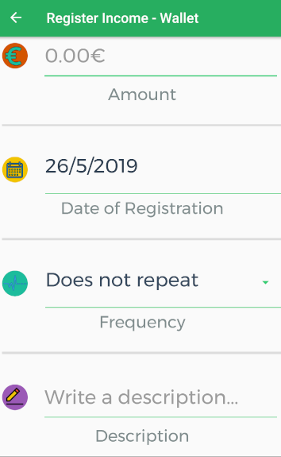
The Prototype - Changes
Creation of periodic incomes/expenses

Slide 16
The Prototype - Changes
“Carroussel view” between wallet and card
*
*Not representative of the final product

Slide 17


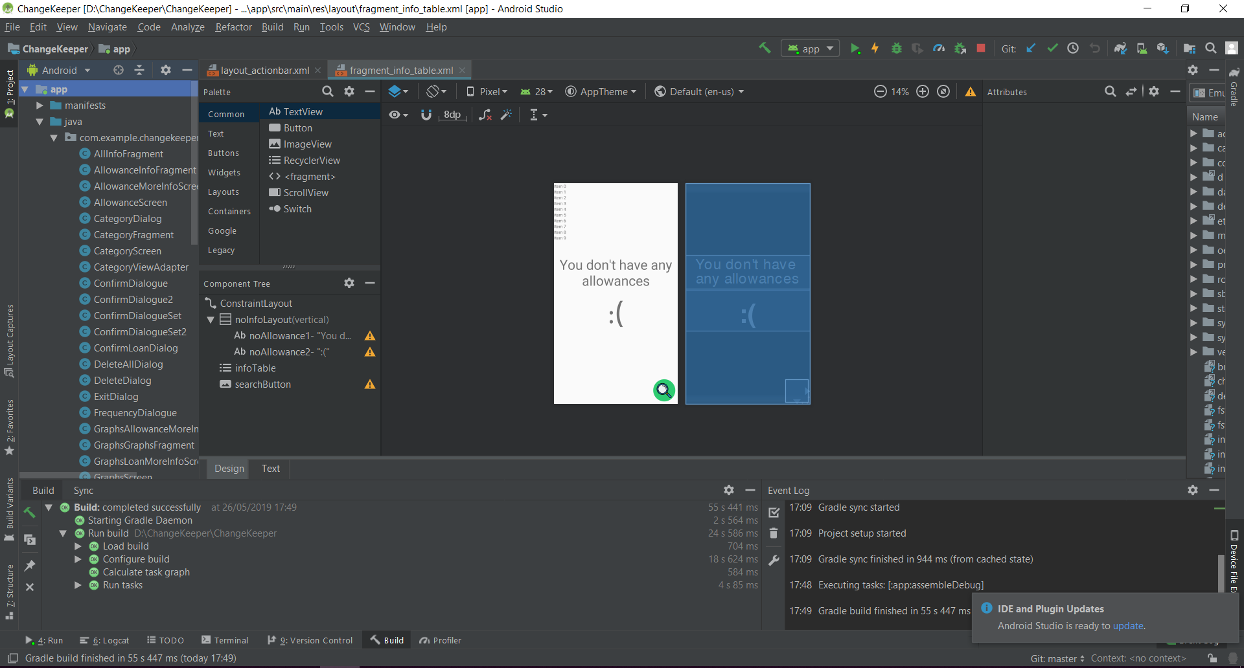
The Development Problems

Slide 18

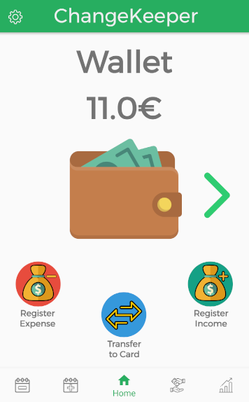

The Development Problems
Wallet/Card Transaction

Slide 19
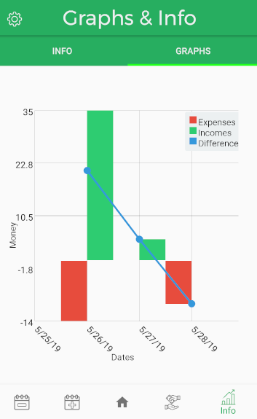
The Development Problems
Graph limitations

Slide 20
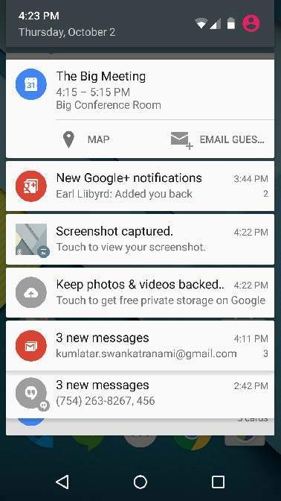
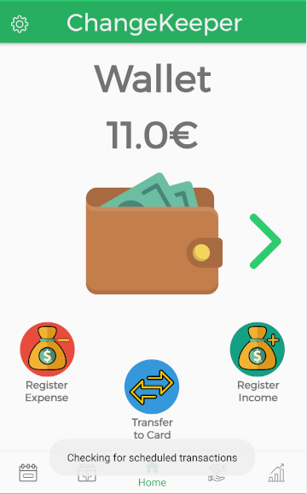
The Development Problems
Notification limitations
*
*For illustrative purposes only! Does not represente final product

Slide 21


The Usability Tests
6 participants
6 assignments
1-5 evaluation
Comments & Feedback

Slide 22
The Usability Tests – Assignments
Regist a 20€ food wallet expense taking place in 20/5/2019 with the description “Lunch with peers”
Add 15€ card monthly income. The starting date should be 18/5/2019 and the description should read “Parent’s Allowance”
Regist that Antonio lent you 30€ in cash, which you’ve promised to pay until the 31st of may (of this year)
You found Antonio and paid him what you owed ahead of time. Regist that you did so
Transfer 5€ from your card to your wallet
Check out info on all the transactions you’ve done up to now

Slide 23
The Usability Tests - Results
Everyone managed to complete all assignments!
More positive feedback! (but…once again…)
Some comments and suggestions on the lack of confirmation transactions…

Slide 24

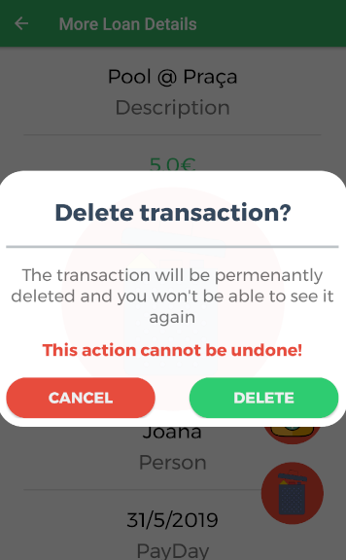
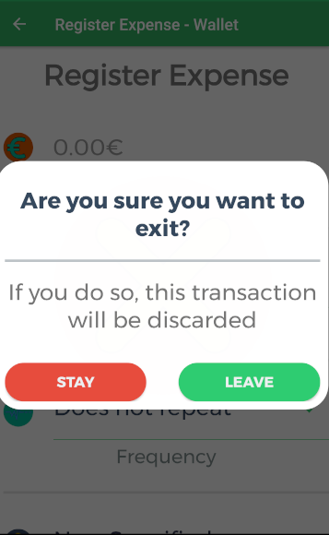
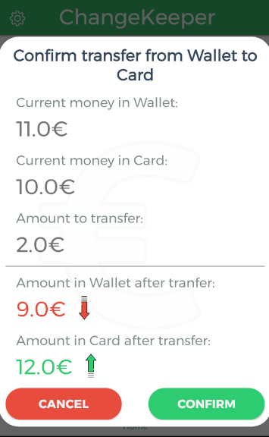
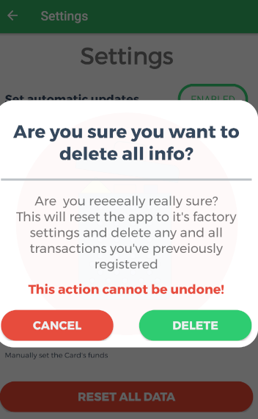
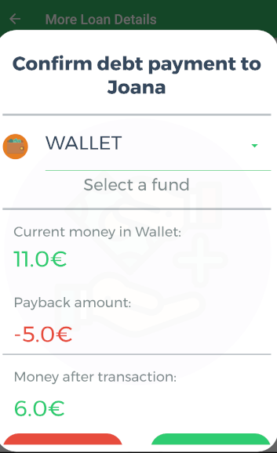
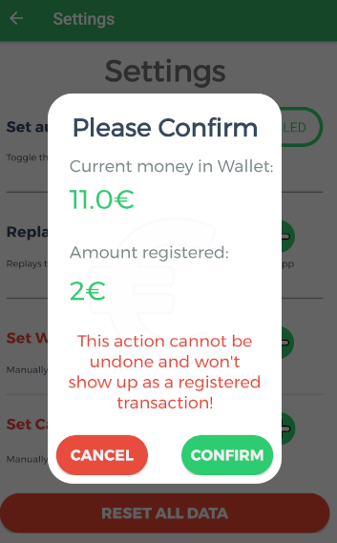
The Usability Tests - Results
So we fixed that !

Slide 25
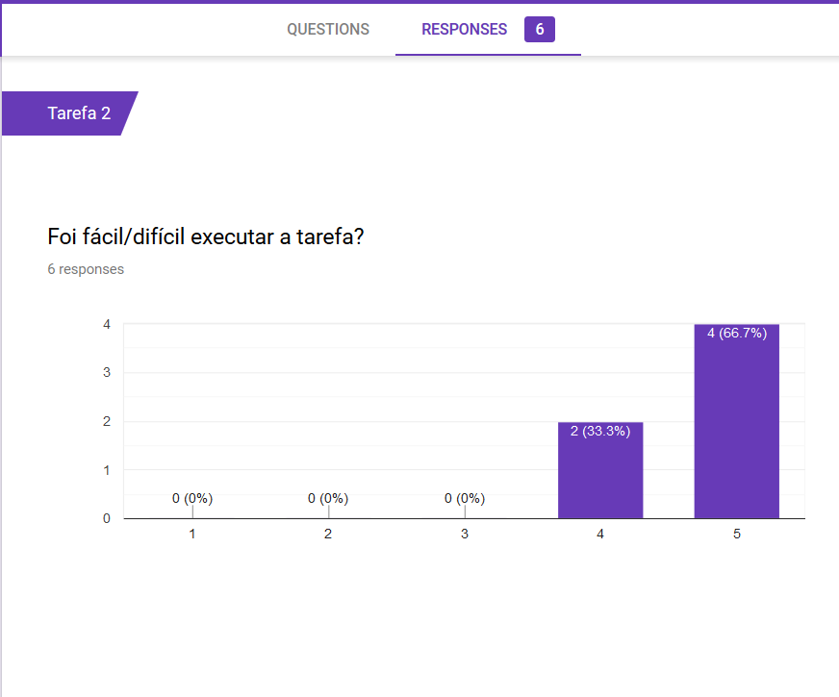
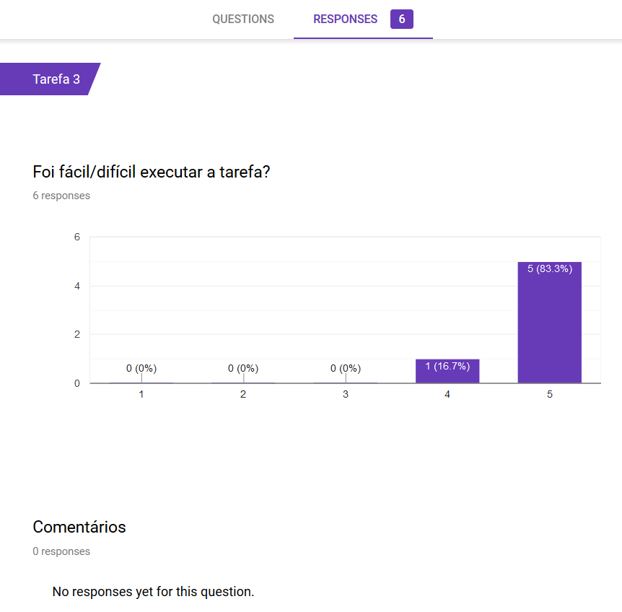
The Usability Tests - Results

Slide 26
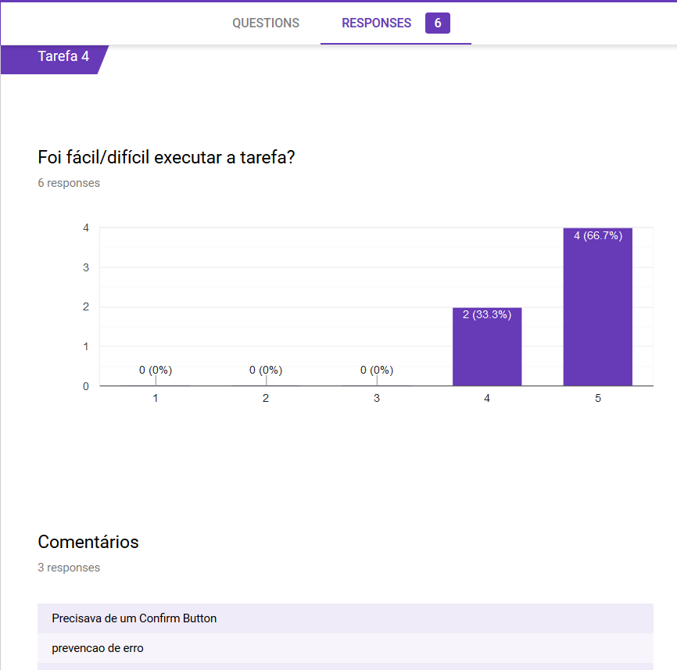
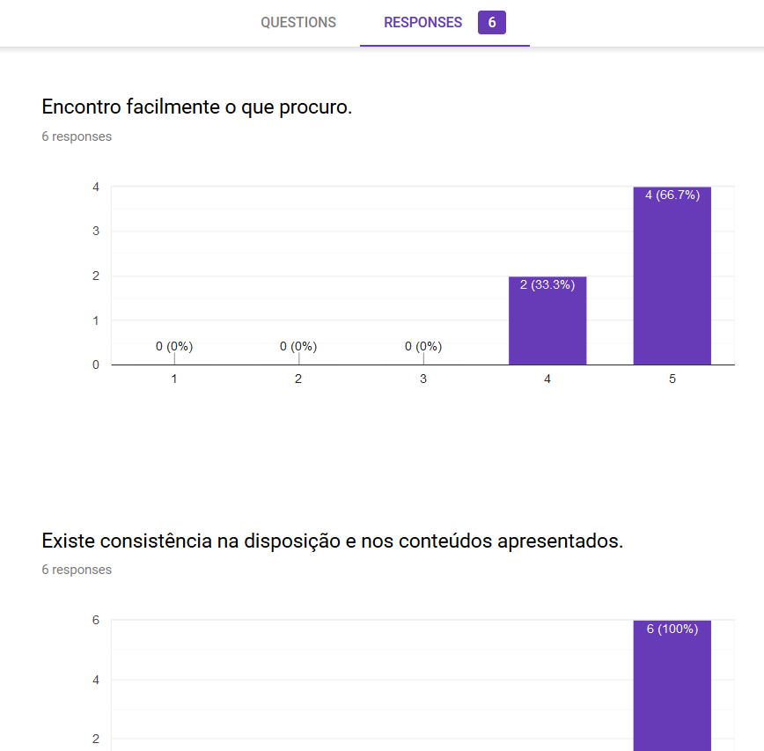
The Usability Tests - Results

Slide 27
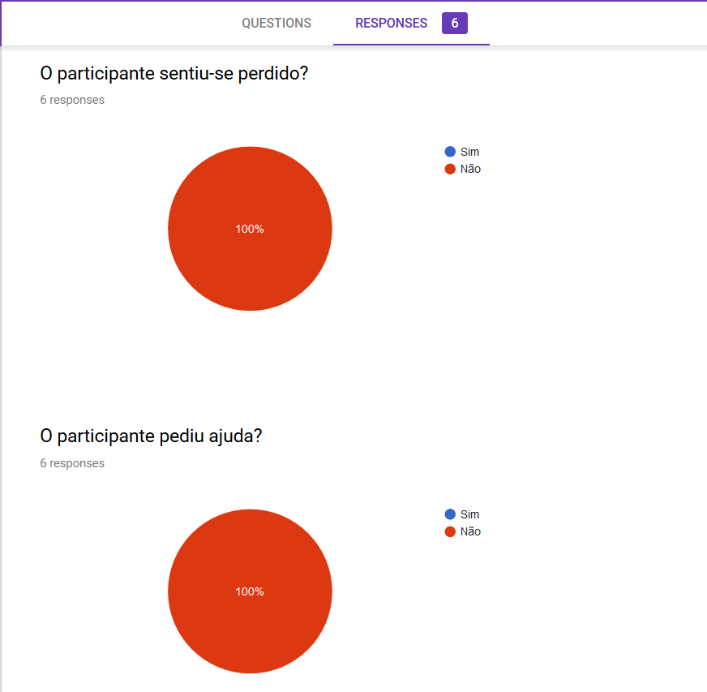
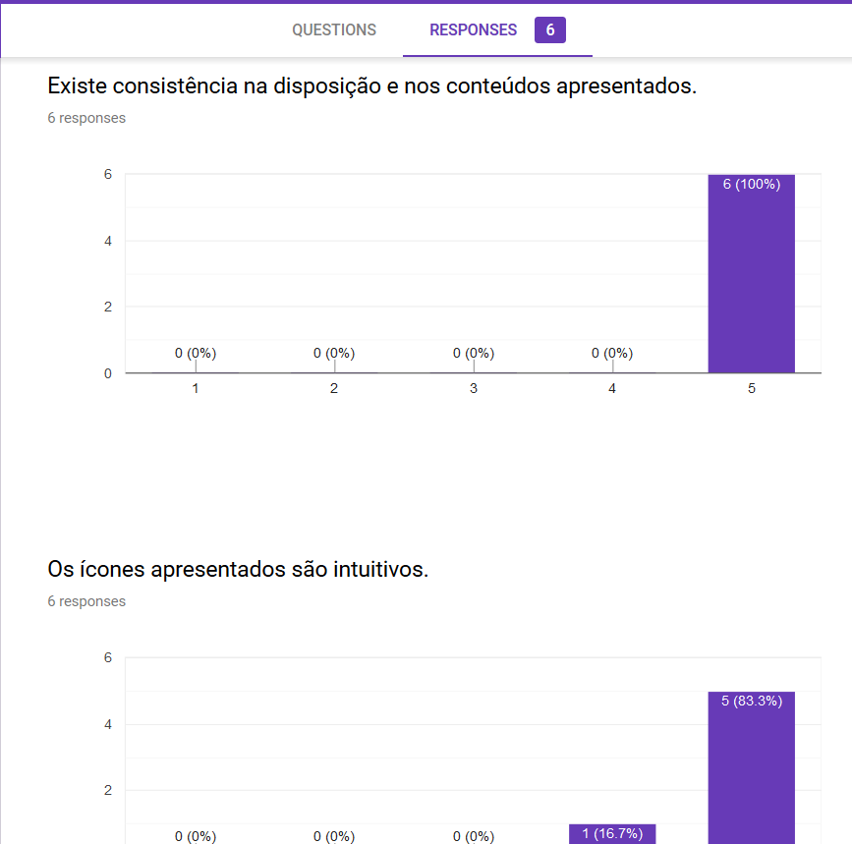
The Usability Tests - Results

Slide 28
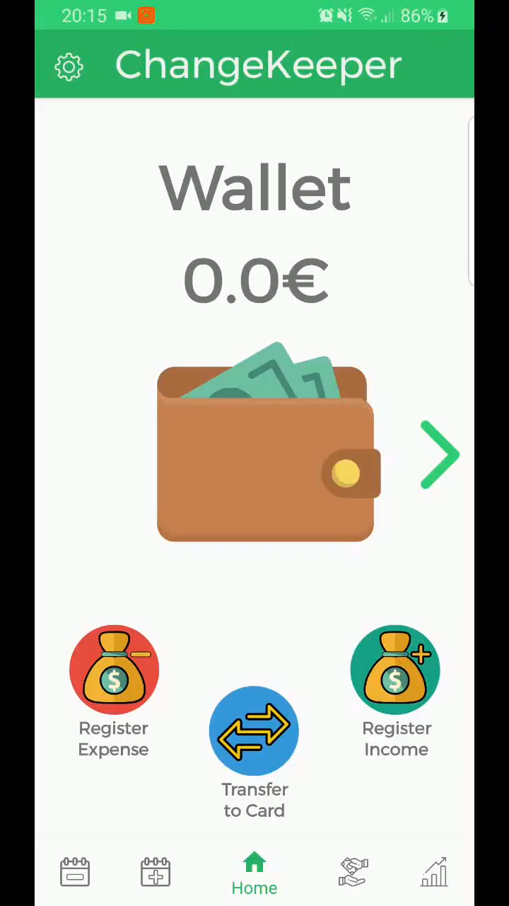
The Demo

Slide 29
ChangeKeeper
29

